Slide 1
PRESENTATION
LOGIC GATES
NAME – MEENAKSHI MANDAVI
BSC – FINAL YEAR (MATHS)
GOVT. NAVEEN COLLEGE GURUR
SUB.TEACHER PRO. L.R.HIRWANI SIR

Slide 2
Contents
DISCOVERY
LOGIC GATE
TYPES OF LOGIC GATE
UNIVERSAL PROPERTY OF NAND & NOR GATES
USES

Slide 3
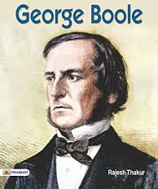
DISCOVERY
* DISCOVERER OF BOOLEAN ALGEBRAL :-
BOOLEAN ALGEBRA WAS DISCOVERED BY GEORGE BOOLE ON 1854
OR | AND | NOT
0+0 = 0 | 0.0 = 0 | 0 = 1 (compliment of 0) 1 = 0 ( compliment of 1)
0+1 = 1 | 0.1 = 0
1+0 = 1 | 1.0 = 0
1+1 = 1 | 1.1 = 1

Slide 4
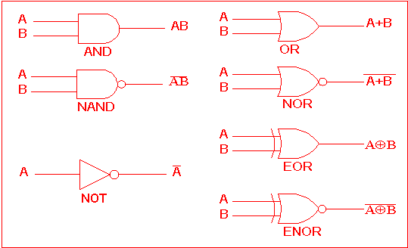
L0gic gates :-
TYPES OF LOGIC GATES :-
1. OR GATE :-
2. AND GATE :-
3. NOT GATE:-
4. NAND GATE :-
5. NOR GATE :-

Slide 5
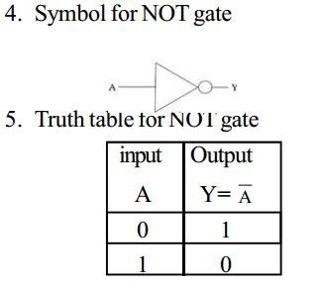
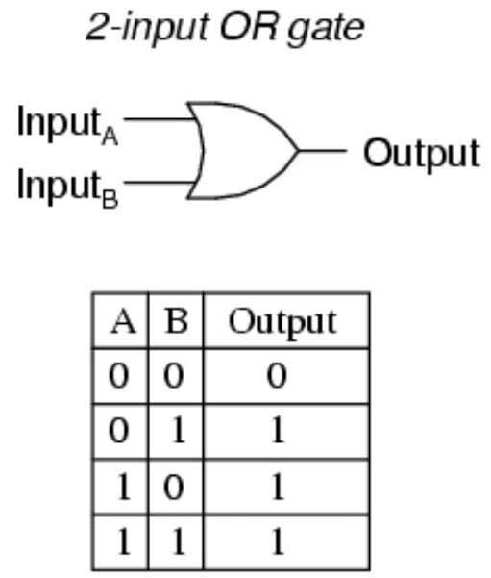
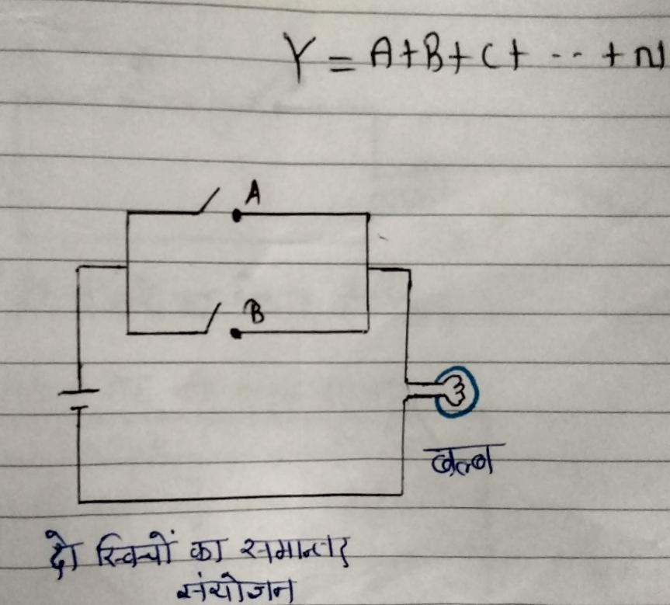
1. OR GATE :-
2. AND GATE :-
3. NOT GATE:-
SWITCHEN CERCUIT OF OR GATE

Slide 6
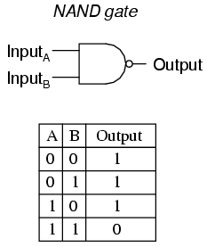
4. NAND GATE :-
5. NOR GATE :-

Slide 7
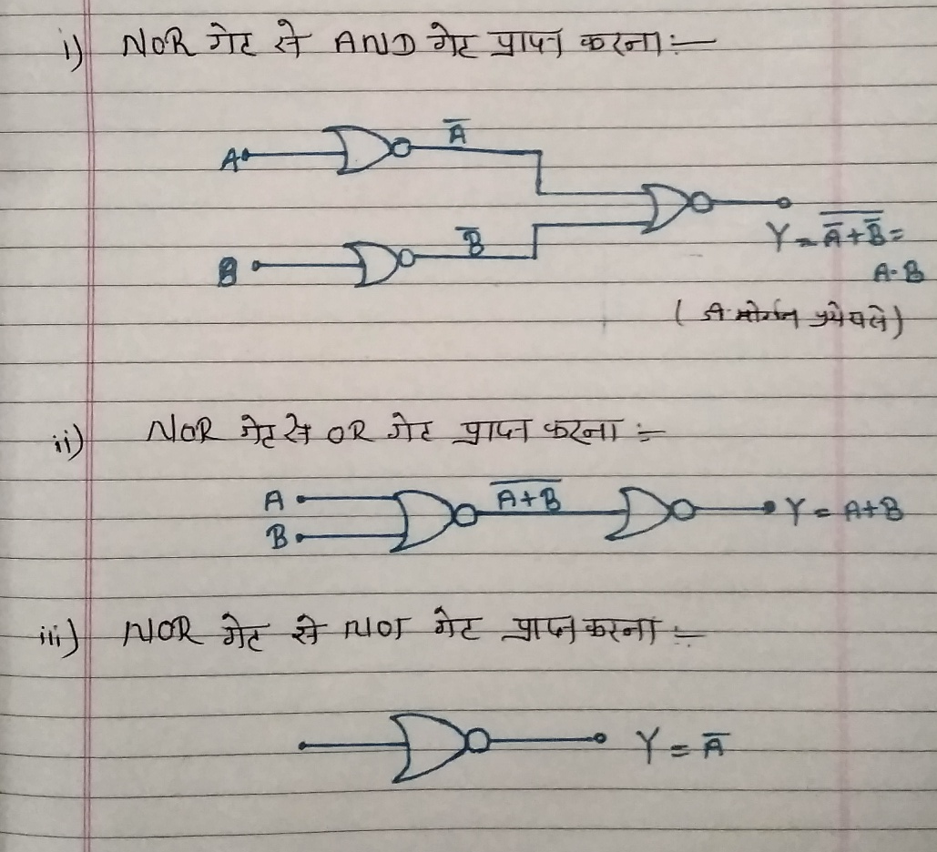
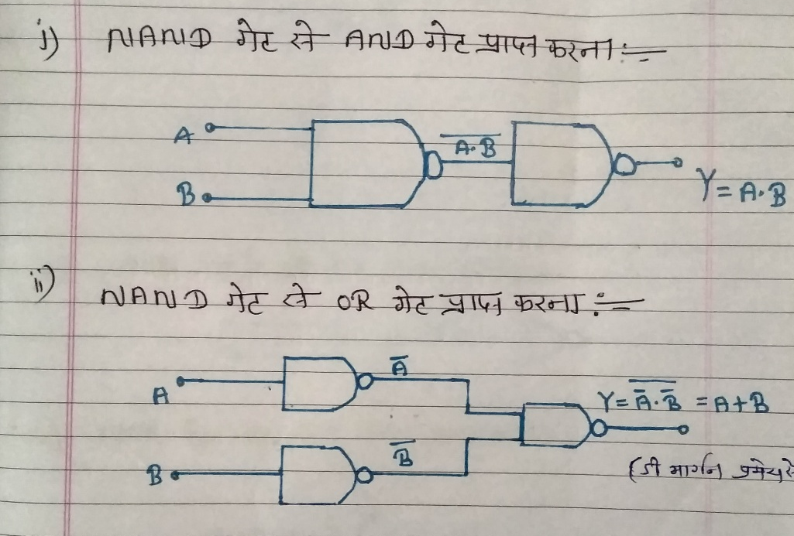
* UNIVERSAL PROPERTY OF NAND GATES :-
* UNIVERSAL PROPERTY OF NOR GATES :-
* USES :-
CALCULATER
COMPUTER

Slide 8
Thank You….

